Slide 1
Robust Robotic Grasping Utilising Touch Sensing
Justin Koo

Slide 2
Progress since last meeting
Develop a baseline approach to classify good grasps from bad grasps; requires data collection, processing & model training pipeline
✅ Extended Pybullet simulation (collab w/ Jeffery) to collect tactile data (DIGIT sensors) and visual data (end effector poses)
✅ Researched on potential baseline: Kernel Logistic Regression

Slide 3
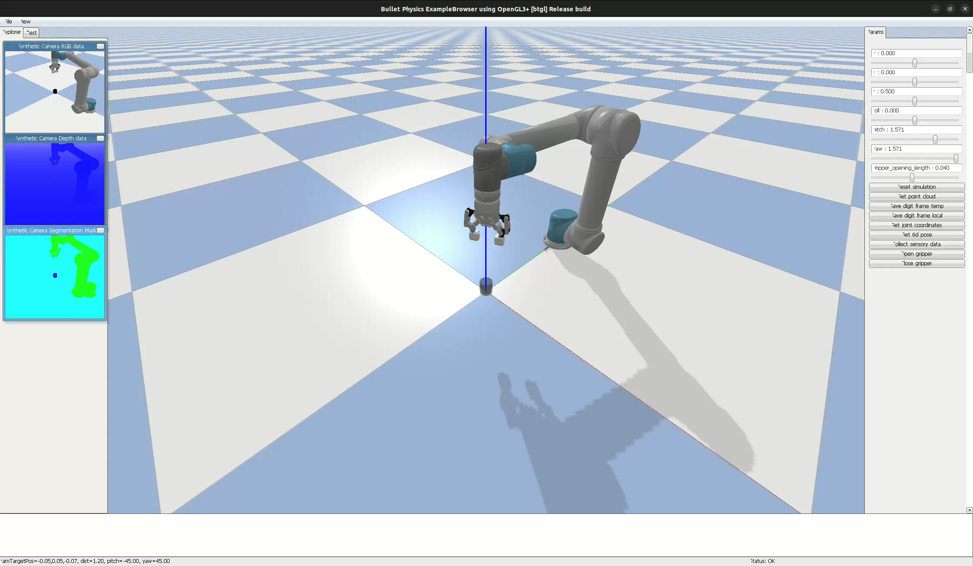

Slide 4
Progress since last meeting (cont)
Develop a baseline approach to classify good grasps from bad grasps; requires data collection, processing & model training pipeline
✅ Extended Pybullet simulation (collab w/ Jeffery) to collect tactile data (DIGIT sensors) and visual data (end effector poses)
✅ Researched on potential baseline: Kernel Logistic Regression
Learn ROS (in progress)
Research on stability classification

Slide 5
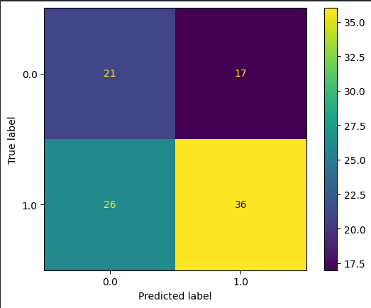
Problems w/ baseline
Tactile readings are stored in a Numpy array of shape (N, 240, 320, 3)
Visual readings are stored in a Numpy array of shape (N, 6)
How to combine these features into a trainable dataset?
Considered product of experts/kernels, but have no idea of a concrete implementation
Temporary solution: concatenating features & fitted w/ basic LR model (57% accuracy, 58% recall)

Slide 6
Once the problem is solved...
Idea of how good are classifiers for determining good grasps from bad ones
Decide on actual approach based on these results
Existing approaches: learning regrasping policies, exploration, GPIS, etc.

Slide 7
End

